Slide 1
Rugged Board
UART
https://community.ruggedboard.com

Slide 2
RB-UART
In the kernel, the UART driver is implemented based on the TTY (TeleTYpewriter)framework.
Many types of terminal drivers are based on TTY, and the UART device is registered as a ttySx character device
(‘x’ stands for the device number).​

Slide 3
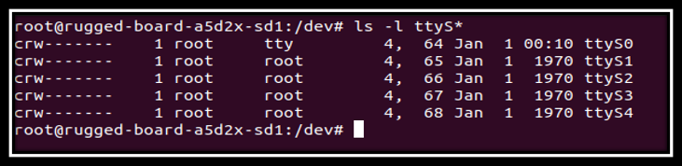
RB-UART
In RuggedBoard there are Five UARTS
UART1 ---> ttyS0 (USB Debug Port (UART to USB) /TTL Debug Port (3.3V))
UART0 ---> ttyS1 (RS232)
UART4 ---> ttyS4 (RS232)
UART2 ---> ttyS2 (RS485)
UART3 ---> ttyS3 (Mikro Bus)

Slide 4
RB-UART
Terminal Attributes
int tcgetattr(int fd, struct termios* info);
The tcgetattr() copies current settings from tty driver associated to the open file fd into the struct pointed by info. Returns 0 on success and -1 on error
int tcsetattr(int fd,int when,struct termios* info);
The tcsetattr() sets the tty driver associated to the open file fd with the settings given in the struct pointed by info. The when argument tells when to update the driver settings.
when argument can take following values:
TCSANOW: update driver settings immediately
TCSADRAIN: wait until all o/p already queued in the driver has been transmitted to the terminal and then update the driver
TCSAFLUSH: wait for o/p queue to be emptied + flush all queued i/p data and then update the driver

Slide 5
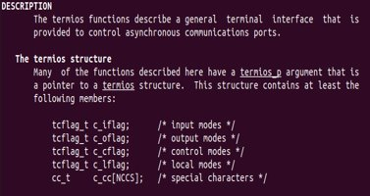
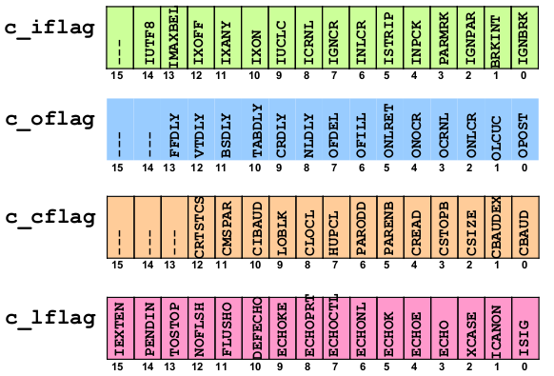
RB-UART
Termios structure
Some important members of the termios structure that of our interest right now are shown below:
Individual Bits of termios Flags
Code snippet to test the echo flag in the c_lflag member of termios structure:
struct termios info;
tcgetattr(0, &info);
if((info.c_lflag & ECHO) == 0)
printf(“echo is off, since its bit is 0”);
else
printf(“echo is on, since its bit is 1”);

Slide 6
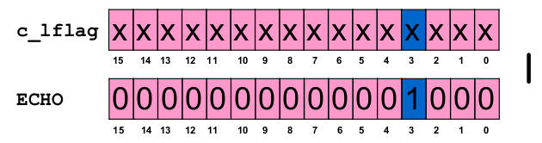
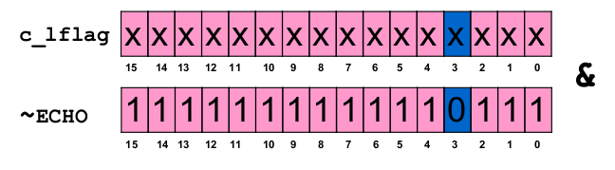
RB-UART
Changing Attributes of Terminal Driver
Three steps to change the attributes of a terminal driver:
● Get the attributes from the driver
● Modify the attribute(s) you need to change
● Send these revised attributes back to the driver
Making the echo Flag ON
struct termios info;
tcgetattr(0, &info);
info.c_lflag = info.c_lflag | ﻿ ECHO;
tcsetattr(0, TCSANOW, &info);
Making the echo Flag OFF
struct termios info;
tcgetattr(0, &info);
info.c_lflag = info.c_lflag & ﻿ ~ECHO;
tcsetattr(0, TCSANOW, &info);

Slide 7
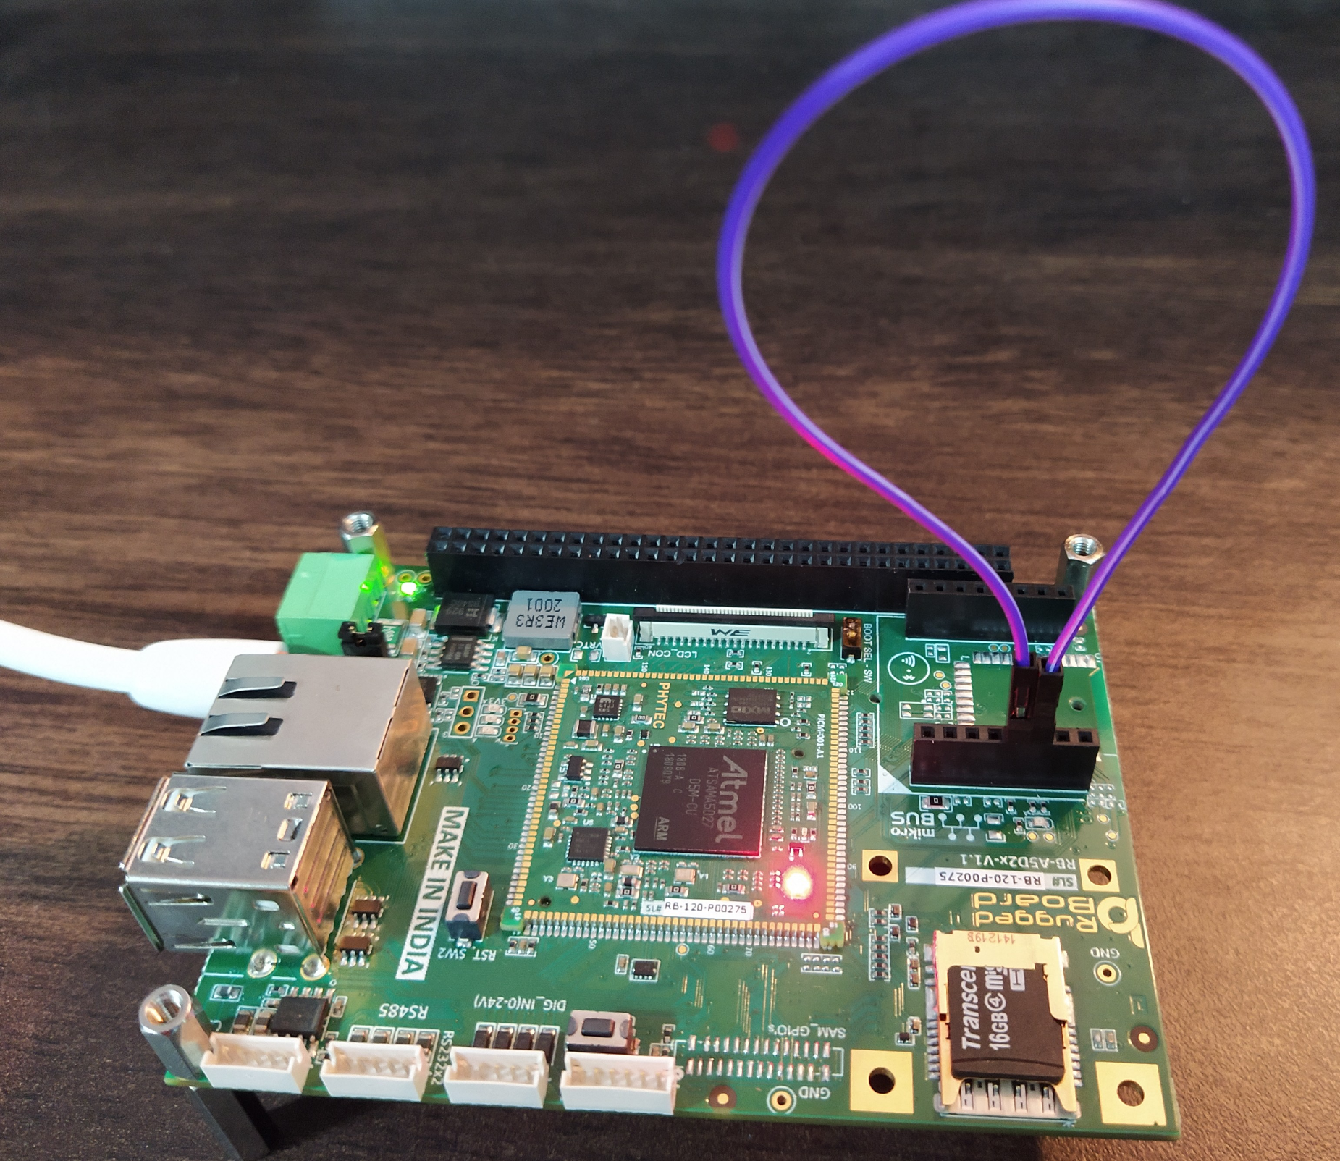
RB-UART
UART3 ---> ttyS3 (Mikro Bus) Loop Back
Step 1: Use open() system call
fd = open("/dev/ttyS3" O_RDWR | O_NOCTTY | O_SYNC);'
Step 2: Set terminal Attributes
struct termios tty;
tcgetattr(fd, &tty)
cfsetispeed(&tty, (speed_t)speed);
tty.c_cflag |= (CLOCAL | CREAD); /* ignore modem controls */
tty.c_cflag &= ~CSIZE;
tty.c_cflag |= CS8; /* 8-bit characters */
tty.c_cflag &= ~PARENB; /* no parity bit */
tty.c_cflag &= ~CSTOPB; /* only need 1 stop bit */
tty.c_cflag &= ~CRTSCTS; /* no hardware flowcontrol */
tty.c_iflag = IGNPAR;
tty.c_lflag = 0;
tty.c_cc[VMIN] = 1;
tty.c_cc[VTIME] = 1;
tcsetattr(fd, TCSANOW, &tty)
Step 3: Use write () and read() system call
write(fd,buf,sizeof(buf));
and
read(fd, buf,sizeof(buf));

Slide 8
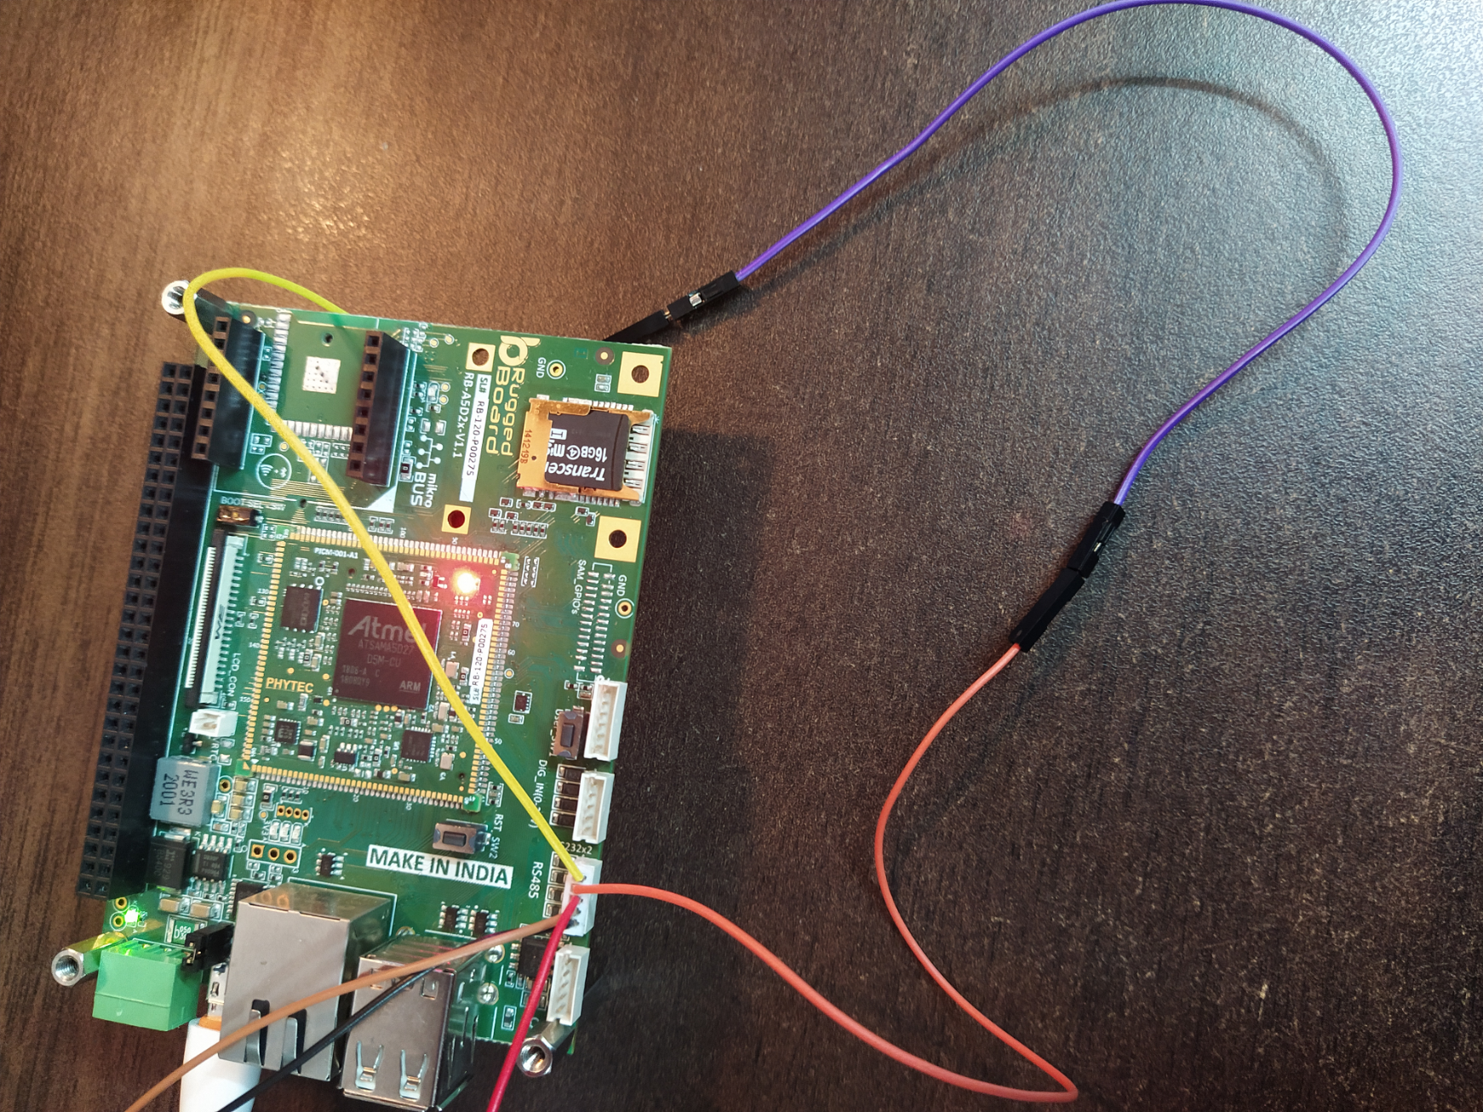
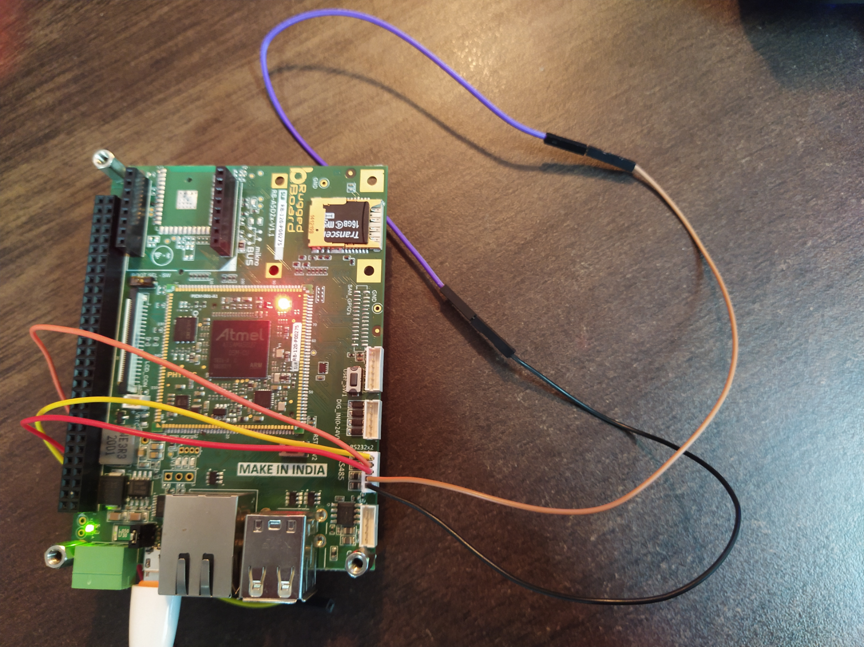
RB-UART
UART3 ---> ttyS1 or ttyS4 (RS232) Loop Back
Step 1: Use open() system call
fd = open("/dev/ttyS1" O_RDWR | O_NOCTTY | O_SYNC);'
Step 2: Set terminal Attributes
struct termios tty;
tcgetattr(fd, &tty)
cfsetispeed(&tty, (speed_t)speed);
tty.c_cflag |= (CLOCAL | CREAD); /* ignore modem controls */
tty.c_cflag &= ~CSIZE;
tty.c_cflag |= CS8; /* 8-bit characters */
tty.c_cflag &= ~PARENB; /* no parity bit */
tty.c_cflag &= ~CSTOPB; /* only need 1 stop bit */
tty.c_cflag &= ~CRTSCTS; /* no hardware flowcontrol */
tty.c_iflag = IGNPAR;
tty.c_lflag = 0;
tty.c_cc[VMIN] = 1;
tty.c_cc[VTIME] = 1;
tcsetattr(fd, TCSANOW, &tty)
Step 3: Use write () and read() system call
write(fd,buf,sizeof(buf));
and
read(fd, buf,sizeof(buf));

Slide 9
Open Discussions

Slide 10





Connect-us
Developer
Wiki

Slide 11


